Slide 1
Oracle 12c: SQL
Chapter 1
Overview of Database Concepts

Slide 2
Objectives
Define database terms
Identify the purpose of a database management system (DBMS)
Explain database design using entity-relationship models and normalization
Explain the purpose of a Structured Query Language (SQL)
Understand how this textbook’s topics are sequenced and how the two sample databases are used
©2016. Cengage Learning. All rights reserved.

Slide 3
What is Data?
Data can be “Facts related to any object in consideration.”
Name, Weight, Height, eye colour, age, etc.
Oracle 11g: SQL

Slide 4
Database Terminology
Database -logical structure to store data
        - Makes the management of data easy
Database management system (DBMS) – software used to create and interact with the database
©2016. Cengage Learning. All rights reserved.

Slide 5
Create records for a business
A new business in town, Bob’s Ice, has decided to ask you to help organize their store by storing all sales data on a computer. You decide the easiest way to do this is to make a spreadsheet.
As a group, create this spreadsheet. Decide how you might organize it. Makes sure you are able to record
Customer name
Phone number
Objects bought
(Cubed, clear, dry)
Make up some data to put in it, as if they had some sales
Date of Sale
Price of objects
Quantity
Anything else?
Oracle 11g: SQL

Slide 6
Bob’s Ice
Name | Phone # | Date | Items bought | Price | Quantity | Final sale
Oracle 11g: SQL

Slide 7
Bob’s Ice
Name | Phone # | Date | Items bought | Price | Quantity | Final sale
Joe F. | 474-4444 | 1/1/19 | Dry ice Cubed | $10.00 $3.00 | 1 | $13.00
Suzie F. | 256-2222 | 2/1/19 | Block | 5 | 2 | 10
Pete L. | 235-3322 | 1/1/19 | Clear | $15.00 | 1 | $15.00
Joe F. | 247-1111 | 1/1/19 | Crushed | $4.00 | 1.5 lb | $6.00
Suzie Q. | 474-4444 | 2/1/19 | Cubed Block | $3.00 $5.00 | 1 2 | $13.00
Oracle 11g: SQL

Slide 8
Bob’s Ice
Name | Phone # | Date | Items bought | Price | Quantity | Final sale
Joe F. | 474-4444 | 1/1/19 | Dry ice Cubed | $10.00 $3.00 | 1 | $13.00
Suzie F. | 256-2222 | 2/1/19 | Block | 5 | 2 | 10
Pete L. | 235-3322 | 1/1/19 | Clear | $15.00 | 1 | $15.00
Joe F. | 247-1111 | 1/1/19 | Crushed | $4.00 | 1.5 lb | $6.00
Suzie Q. | 474-4444 | 2/1/19 | Cubed Block | $3.00 $5.00 | 1 2 | $13.00
Oracle 11g: SQL

Slide 9
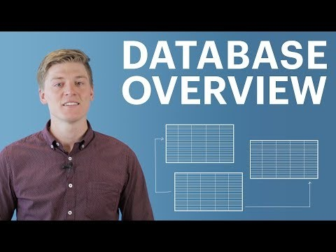
Oracle 11g: SQL

Slide 10
Database Components
Character
Field
Record
File
©2016. Cengage Learning. All rights reserved.

Slide 11
Database Components - Character
Basic unit of data
Can be a letter, number, or special symbol
©2016. Cengage Learning. All rights reserved.

Slide 12
Database Components - Field
A group of related characters
Represents an attribute or characteristic of an entity
Corresponds to a column in the physical database
©2016. Cengage Learning. All rights reserved.

Slide 13
Database Components - Record
A collection of fields for one specific entity
Corresponds to a row in the physical database
©2016. Cengage Learning. All rights reserved.

Slide 14
Database Components - File
A group of records about the same type of entity
©2016. Cengage Learning. All rights reserved.

Slide 15
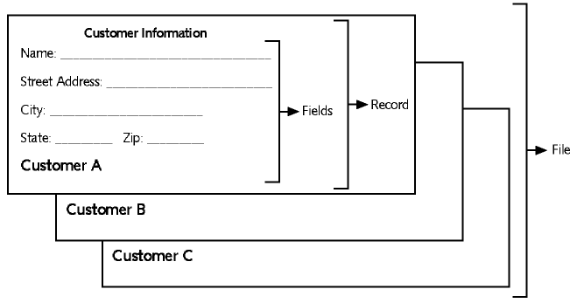
Components Example
©2016. Cengage Learning. All rights reserved.

Slide 16
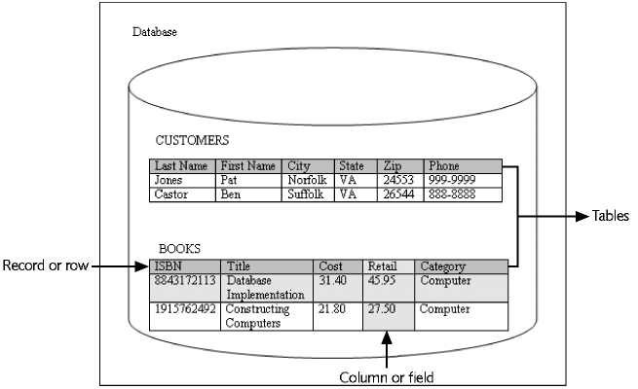
Database Example
©2016. Cengage Learning. All rights reserved.

Slide 17
Database Management System
Data storage: manage the physical structure of the database
Security: control user access and privileges
Multiuser access: manage concurrent data access
Backup: enable recovery options for database failures
Data access language: provide a language that allows database access
Data integrity: enable constraints or checks on data
Data dictionary: maintain information about database structure
©2016. Cengage Learning. All rights reserved.

Slide 18
Database Design
Systems Development Life Cycle (SDLC)
Entity-relationship model (E-R model)
Normalization
©2016. Cengage Learning. All rights reserved.
Notes:
In order to determine the most appropriate structure of fields, record, and files in a database, developers go through a design process. This system is called the SDLC
An E-R model is a diagram that identifies the entities in the database, and it shows how the entities are related.
Normalization is used to create a design that reduces/eliminates data redundancy and, therefore, avoids data anomalies.

Slide 19
Systems Development Life Cycle (SDLC)
Systems investigation – understanding the problem
Systems analysis – understanding the solution
Systems design – creating the logical and physical components
Systems implementation –creating the system
Systems integration/testing – testing system
Systems deployment – placing completed system into production
Systems maintenance and review – evaluating the implemented system
©2016. Cengage Learning. All rights reserved.

Slide 20
Entity-Relationship Model
(E-R Model)
Used to depict the relationship that exists among entities
The following relationships can be included in an E-R model:
  One-to-one
  One-to-many
  Many-to-many
©2016. Cengage Learning. All rights reserved.

Slide 21
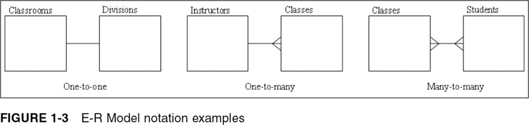
E-R Model Notation Examples
©2016. Cengage Learning. All rights reserved.

Slide 22
One-to-One Relationship
Each occurrence of data in one entity is represented by only one occurrence of data in the other entity
Example: Each individual has just one Social Security number (SSN) and each SSN is assigned to just one person
©2016. Cengage Learning. All rights reserved.

Slide 23
One-to-Many Relationship
Each occurrence of data in one entity can be represented by many occurrences of the data in the other entity
Example: A class has only one instructor, but each instructor can teach many classes
©2016. Cengage Learning. All rights reserved.

Slide 24
Many-to-Many Relationship
Data can have multiple occurrences in both entities
Example: A student can take many classes, and each class is composed of many students
Can not be included in the physical database
©2016. Cengage Learning. All rights reserved.

Slide 25
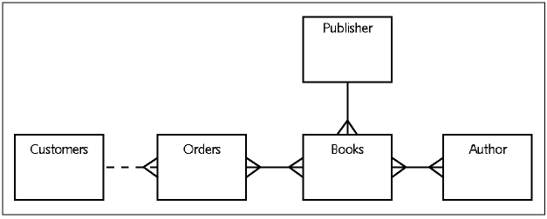
JustLee Example E-R Model
©2016. Cengage Learning. All rights reserved.

Slide 26
Database Normalization
Determines required tables and columns for each table
Multistep process
Used to reduce or control data redundancy
©2016. Cengage Learning. All rights reserved.
Notes:
Many people unfamiliar with database design principlaes often ask

Slide 27
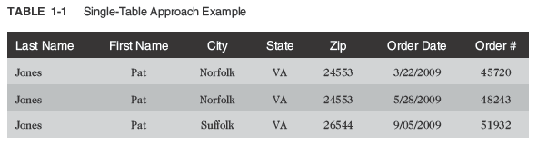
Database Normalization (continued)
Data redundancy – refers to having the same data in different places within a database
Data anomalies – refers to data inconsistencies
©2016. Cengage Learning. All rights reserved.

Slide 28
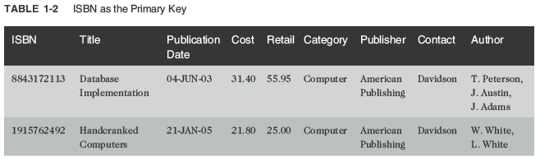
Unnormalized Data
Contains repeating groups in the Author column in the BOOKS table
©2016. Cengage Learning. All rights reserved.

